Slide 1
Revealing Air Traffic Control capacity-demand imbalances by spatio-temporal forecasts
Zvonimir Rezo, PhD.
Institute of Transport and Communications, Zagreb, Croatia
Research Workshop Predictability and Flexibility in ATM 18-19 April 2024, Zagreb, Republic of Croatia
April 19th 2024

Slide 2
PRESENTATION CONTENT
Solution utilisation
Validation through application
Validation
Development
Solution developemnt
Background research
Development of methodological and conceptual frameworks
Deficiencies identification
Review of literature, regulatory and methodological frameworks
Research Workshop Predictability and Flexibility in ATM 18-19 April 2024, Zagreb, Republic of Croatia

Slide 3
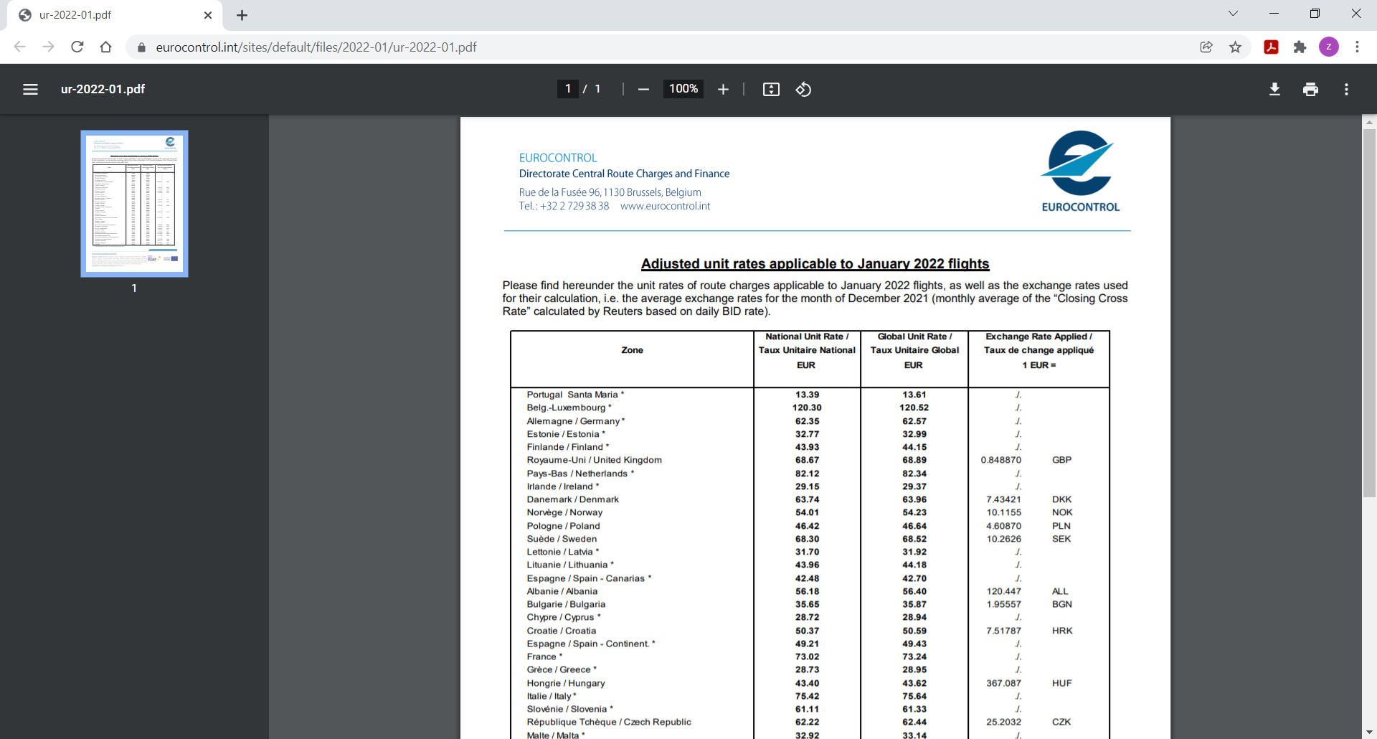
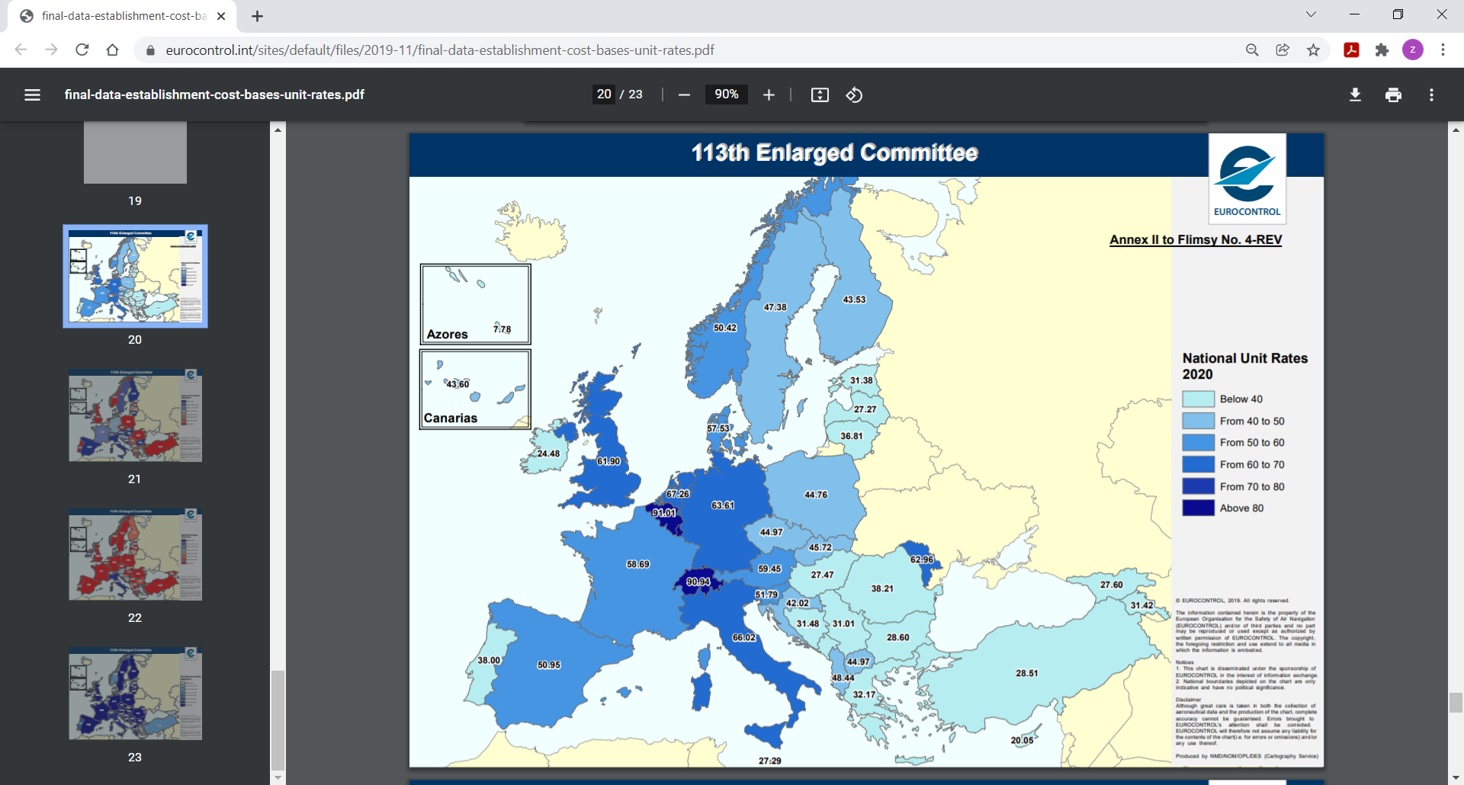
RESEARCH BACKGROUND | TELL ME WHAT YOU SEE?
KPA/KPI
Historgram vs. map
Research Workshop Predictability and Flexibility in ATM 18-19 April 2024, Zagreb, Republic of Croatia

Slide 4
RESEARCH BACKGROUND | TELL ME WHAT YOU SEE?
Attributive distribution
Network configuration
Spatial distribution
$w_{i}$ ≠ $w_{j}$ $w_{i_{1}}$ ≠ $w_{i_{2}}$ ≠ $w_{j_{1}}$ ≠ $w_{j_{2}}$
$w_{i}$ nucleated $w_{i_{1}}$ clustered ${ w}_{i_{2}}$random
$w_{j}$ linear $w_{j_{1}}$ clustered $w_{j_{2}}$dispersed
Research Workshop Predictability and Flexibility in ATM 18-19 April 2024, Zagreb, Republic of Croatia

Slide 5
FORECAST DEVELOPMENT
Development background:
Spatio-temporal forecasting methods that use information from neighbouring units to improve the forecasts of a target unit.
Spatio-temporal forecast’ conceptualisation:
multi-variate time series data in which there is a spatial dependency
algorithms enabling spatio-temporal forecasting; application of Exploratory Spatial Data Analysis (ESDA) combined with Artificial Neural Networks (ANN) - ideal for pattern recognition.
Research Workshop Predictability and Flexibility in ATM 18-19 April 2024, Zagreb, Republic of Croatia

Slide 6
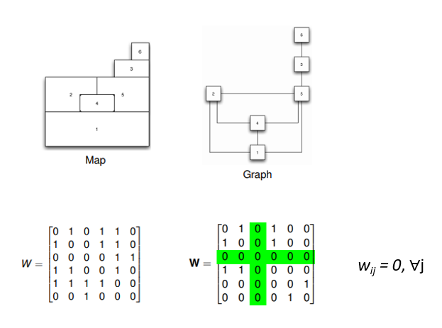
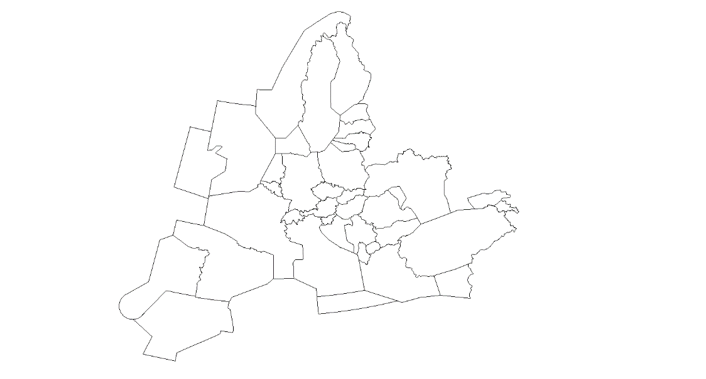
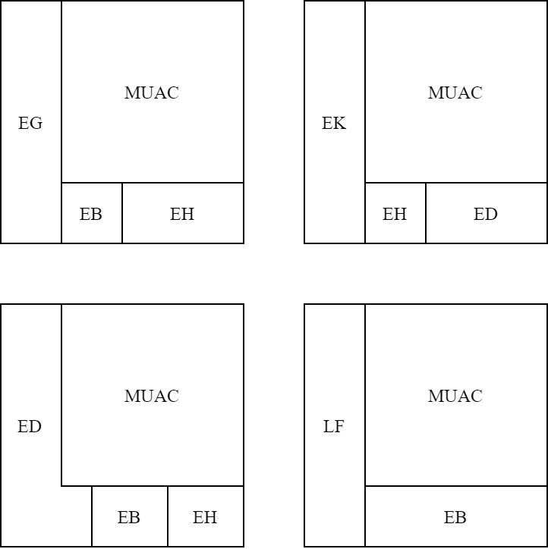
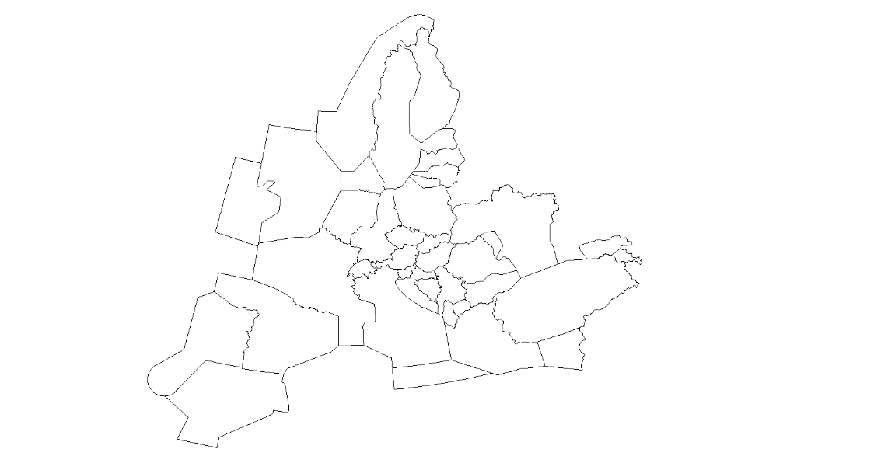
FORECAST DEVELOPMENT – SOLUTION CONFIGURATION
Research Workshop Predictability and Flexibility in ATM 18-19 April 2024, Zagreb, Republic of Croatia

Slide 7
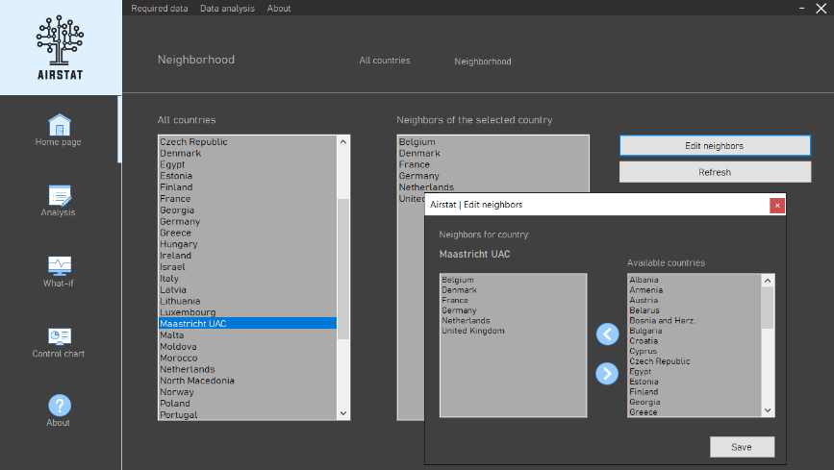
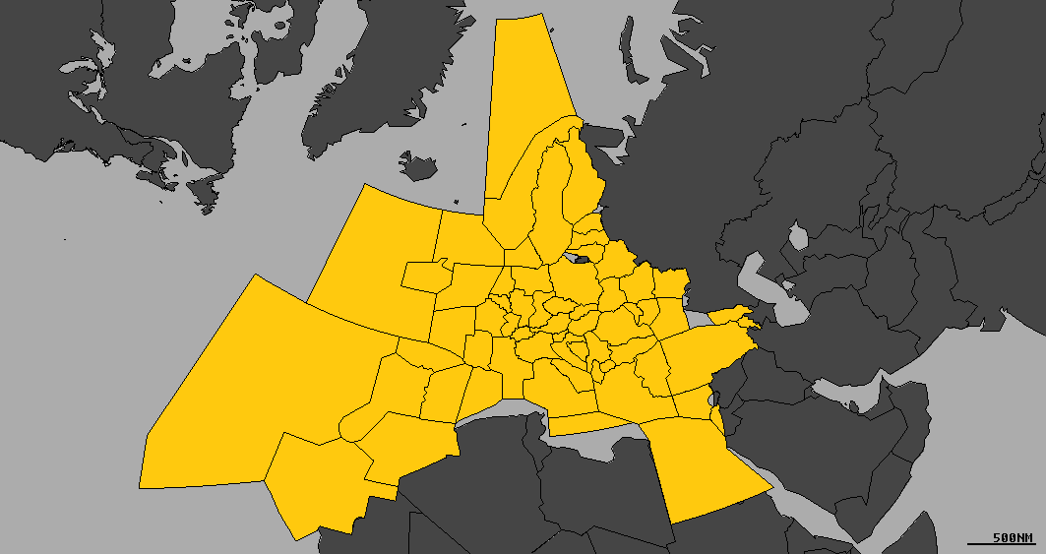
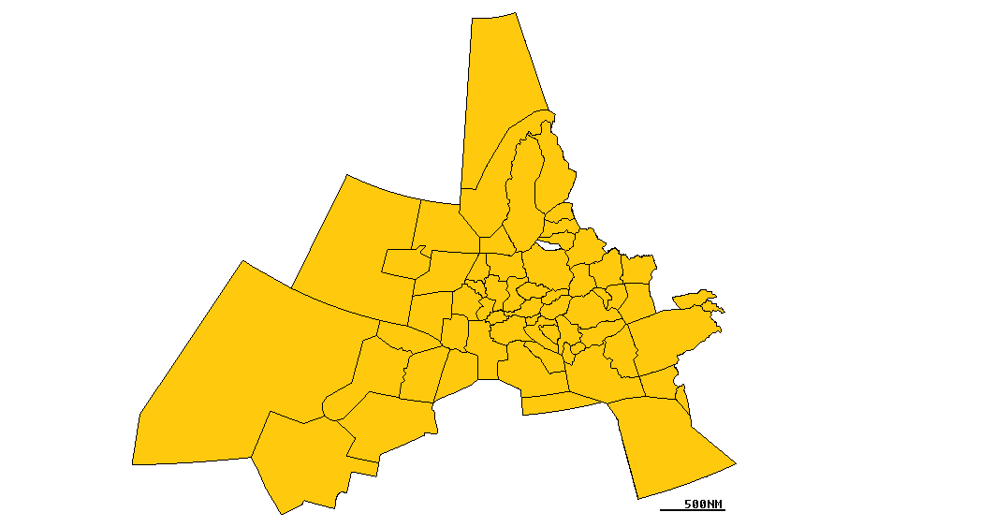
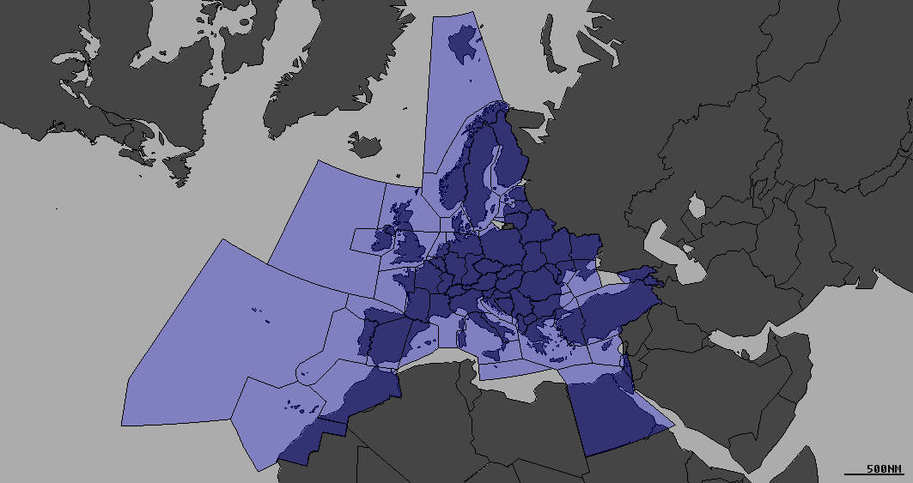
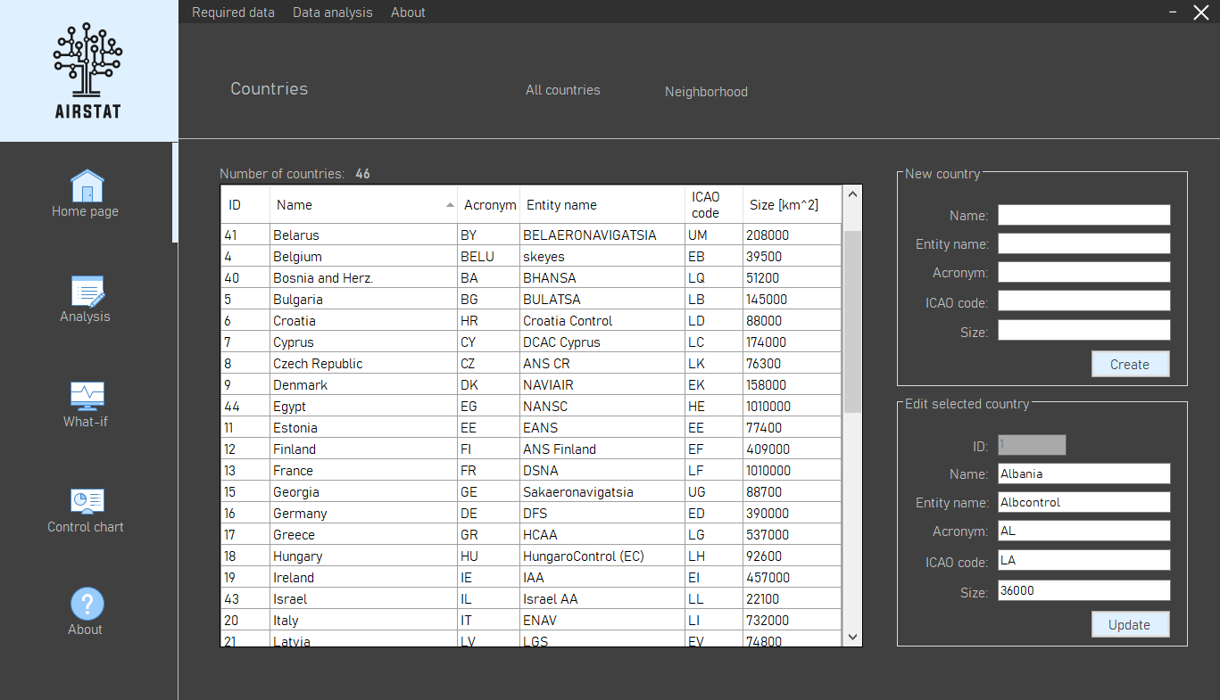
FORECAST DEVELOPMENT – SOLUTION CONFIGURATION
Research Workshop Predictability and Flexibility in ATM 18-19 April 2024, Zagreb, Republic of Croatia

Slide 8
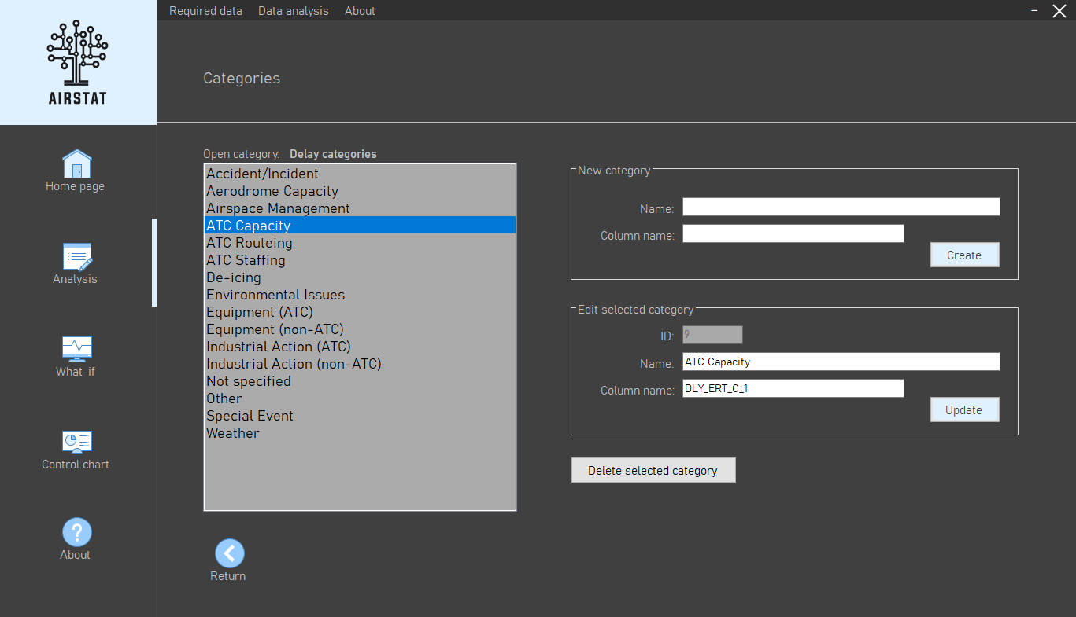
SOLUTION APPLICATION | RESULTS VALIDATION
Training period: 2014 - 2017
Error identification:
• NOP forecast vs. actual 2018 performance
• R&D forecast vs. actual 2018 performance
• R&D forecast vs. NOP forecast
Reference year: 2018
Key perfromance area:
• Capacity
Input data:
• ENR ATFM delay [min/flight]
Data source:
• Performance Review Unit (PRU)
• Network Operation Plan (NOP)
• LSSIPs
Methodologi assumptions
Define volatility
Research Workshop Predictability and Flexibility in ATM 18-19 April 2024, Zagreb, Republic of Croatia

Slide 9
SOLUTION APPLICATION | RESULTS VALIDATION
Annual performance volatility during training period
Research Workshop Predictability and Flexibility in ATM 18-19 April 2024, Zagreb, Republic of Croatia

Slide 10
SOLUTION APPLICATION | RESULTS VALIDATION
Research Workshop Predictability and Flexibility in ATM 18-19 April 2024, Zagreb, Republic of Croatia

Slide 11
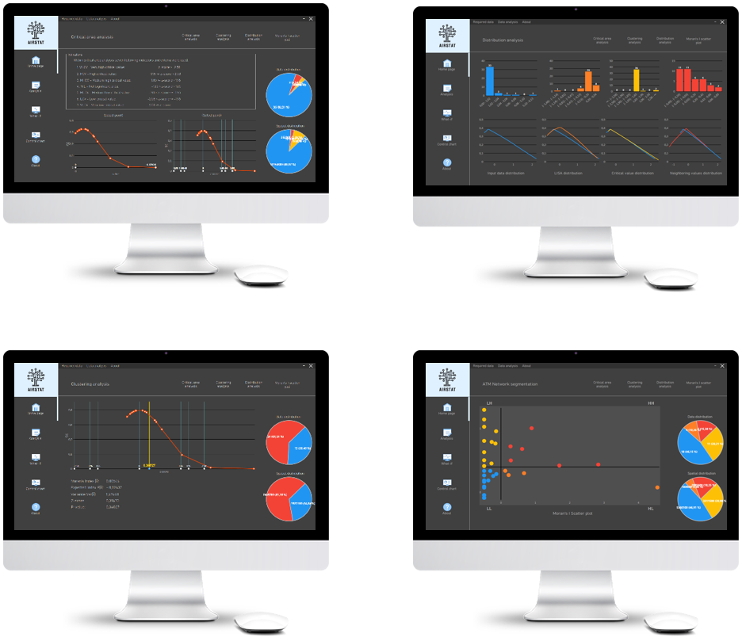
SOLUTION APPLICATION | CONSOLIDATED OVERVIEW
ENR ATFM delay [min/flight]
Global Moran’s I: 0,230891
Variance: 0,191860
z-score: 2,76826 > 1,96
p-value: 0,00280 < 0,05
Approximation accuracy
R&D / NOP: avg. 64.85%
R&D / 2018: avg. 84.72%
Research Workshop Predictability and Flexibility in ATM 18-19 April 2024, Zagreb, Republic of Croatia

Slide 12
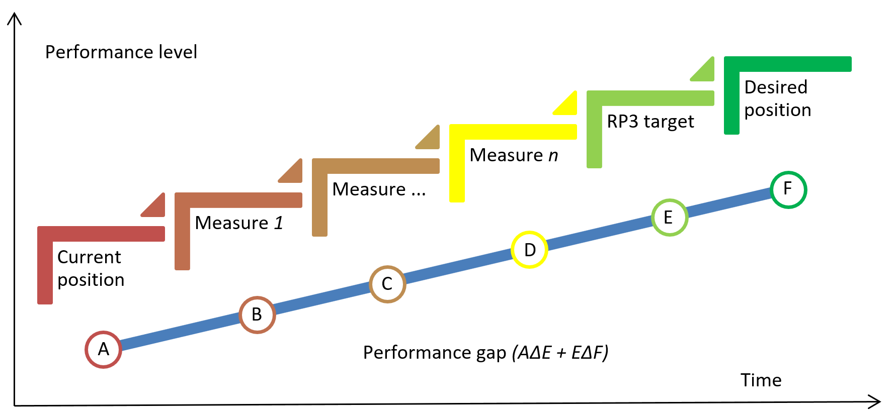
SOLUTION APPLICABILTIY & RELEVANCE
Performance management | From data, over information to proactive change management
0.34 [min/flight]
0.50 [min/flight]
RP2
1.10 [min/flight]
Research Workshop Predictability and Flexibility in ATM 18-19 April 2024, Zagreb, Republic of Croatia

Slide 13
Revealing Air Traffic Control capacity-demand imbalances by spatio-temporal forecasts
Zvonimir Rezo, PhD.
Institute of Transport and Communications, Zagreb, Croatia
Thank you for your attention!
Email address: zvonimir.rezo@gmail.com
Email address: zrezo@fpz.unizg.hr
Research Workshop Predictability and Flexibility in ATM 18-19 April 2024, Zagreb, Republic of Croatia
April 19th 2024

